Slide 1
Lecture 5
Bottom-Up Parsing

Slide 2
Outline
Overview of Bottom-Up Parsing
Overview of LR Parsing Method
Finite Automata of LR(0) Items and LR(0) Parsing
SLR(1) Parsing

Slide 3
Finite Automata of LR(0) Items and LR(0) Parsing
LR(0) Parsing
The LR parser using LR(0) parsing table is LR(0) parser; The grammar for which an LR(0) parsing table can be constructed is said to be LR(0) grammar
LR(0) parser uses only the content of stack to determine handle, it doesn't need input token as lookahead
Almost all “real” grammars are not LR(0), but LR(0) method is a good starting point for learning LR parsing

Slide 4
Constructing LR(0) Parsing Table
LR(0) Items
Finite Automata of LR(0) Items
Constructing LR(0) Parsing Table

Slide 5
LR(0) Items
LR(0) Item
A LR(0) item of a grammar G is a production of G with a distinguished position in its right-hand side
For example, production U→XYZ has four items
[0] U→ • XYZ [1] U→X • YZ
[2] U→XY • Z [3] U→XYZ •
production A→ε has only one item A→•
These are called LR(0) items because they contain no explicit reference to lookahead

Slide 6
The Meaning of Items
An item records an intermediate step in the recognition of the right-hand side of a production
A→ • βγ means that we may be about to recognize an A by using production A→ βγ
A→β • γ means that β has already been seen (β must appear at the top of stack)
A→ βγ • means that βγ now resides on the top of the stack and may be the handle, and A-> βγ is to be used for the next reduction

Slide 7
Categories of Items
Initial Item
Item of the form A→ • α, means the initial of recognizing α
Complete Item
Item of the form A→α • , means the completeness of recognizing α

Slide 8
Finite Automata of Items
The LR(0) items can be used as the states of a finite automaton that maintains information about the parsing stack and the progress of a shift-reduce parsing
1 Construct NFA of LR(0) Items
2 Construct DFA of Sets of LR(0) Items Directly

Slide 9
All items of G’ :
1．S’→•E 2．S’→E• 3．E→•aA
4．E→a•A 5．E→aA• 6．A→•cA
7．A→c•A 8．A→cA• 9．A→•d
10. A→d• 11. E→•bB 12. E→b•B
E→bB• 14. B→•cB
15. B→c•B
B→cB•
B→•d
B→d•
The NFA of items
ε
6
c
7
A
8
ε
ε
ε
9
d
10
a
A
5
3
4
ε
E
2
1
ε
11
b
12
B
13
ε
d
18
ε
17
ε
c
B
16
14
15
ε

Slide 10
The DFA of sets of items
c
A
I₈：A →cA·
I₄：A→c·A
A→·cA
A→·d
d
I₁₀：A →d·
c
d
I₂：E→a·A
A→·cA
A→·d
A
I₆：E →aA·
a
E
I₀：S’→·E
E→·aA
E→·bB
I₁：S’ →E·
B
I₃：E→b·B
B→·cB
B→·d
I₇：E →bB·
b
d
c
d
I₁₁：B →d·
I₅：B→c·B
B→·cB
B→·d
I₉：B →cB·
B
c

Slide 11
Construct DFA of Sets of Items Directly
Augmented grammar
Before constructing DFA, first augment the grammar by a single production S’->S, where S’ is a new non-terminal, it becomes the start symbol of the Augmented grammar
S’-> •S becomes the first item in the start state of the DFA
Example G[E]: E->aA | bB A->cA|d B->cB | d
Augmented grammar G’[S’]: S’->E E->aA | bB A->cA|d B->cB | d

Slide 12
Construct DFA of Sets of Items Directly
Each state of DFA is a set of LR(0) items
How to construct a state?----closure operation
A transition on symbol X from state i to state j
If X is a token, this transition corresponds to a shift of X from the input to the top of the stack during a parse
If X∈V_{N}, this transition corresponds to the pushing of X onto the stack. It can only occur during a reduction by a production X→r
How to construct transition form one state to another?----goto operation
X
A→α•Xβ
…
A→αX•β
…

Slide 13
1) The Closure Operation
If I is a set of LR(0) items, then closure(I) is the set of items constructed from I by the following rules:
Initially, closure(I) = I;
If A->α•Bβ is in closure(I) and B ∈V_{N} , then for each production B→r, add the item B→•r to closure(I), if it is not there.
Repeat b) until no more new items are added
For each item where ‘ • ’ is at the right end or followed by a terminal, closure of this item is the item itself

Slide 14
Example G’: S’->E E->aA | bB A->cA|d B->cB | d
if I={ S’→•E } then
closure(I)={ S’->•E,
E->•aA,
E->•bB }

Slide 15
2) The goto Operation
I is a set of items, X∈V_{N}∪V_{T}
goto(I, X)= closure(J)
where J is the set of all items [ A→αX•β] such that [A→α• Xβ] is in I
Example:
S’→E E→aA | bB A→cA|d B→cB | d
I = { S’→•E, E→•aA, E→•bB }
goto(I, E)=closure({ S’→E•})={ S’→E•}
goto(I,a) = closure({E→a•A})
={E→a•A,A→•cA,A→•d }
goto(I, b) = closure({ E→b•B })
={ E→b•B,B→•cB,B→•d }

Slide 16
3) The Construction of DFA
closure({S’→•S}) is the start state of DFA, and it is unlabeled
Get an unlabeled state IS_{i} from DFA
Label IS_{i}
For each item U->x•Ry (R∈ V_{N}∪V_{T}, x and y are strings) of IS_{i}, compute goto(IS_{i},R)=IS_{j}
Add IS_{j} to DFA as unlabeled if it is not there
Add a transition form IS_{i} to IS_{j} on R
Repeat b) until there is no unlabeled state in DFA

Slide 17
Example: augmented grammar G’:
S’→E E→aA | bB A→cA|d B→cB | d
The construction of DFA
E→bB•
B→d•
I₇
I₉
B
d
c
d
E→b•B
I₃
c
B→c•B
b
B→•cB
B→•d
I₈
B
B→cB•
S’→•E
B→•cB
B→•d
I₁₁
I₀
E→•aA
E→•bB
I₂
a
E→a•A
A→c•A
c
I₅
A→•cA
A→•d
A
A→cA•
E
A→•cA
A→•d
I₁₀
S’→E•
I₁
A
d
d
c
E→aA•
I₄
A→d•
I₆
17
Notes:
17

Slide 18
Constructing LR(0) Parsing Table
 | ACTION | GOTO
 |  | a | c | e | b | d | $ | S | A | B
0 | Shift | 2 |  |  |  |  |  | 1
1 | R1
2 | Shift |  | 1 |  | 3
3 | R2
LR(0) Parsing Table
ACTION: LR(0) parsing does not consult input token, so LR(0) parsing states are either “shift” states or “reduce” states
GOTO: There must be a column for every symbol (V_{N},V_{T} and $ )

Slide 19
Construction of LR(0) Parsing Table
Given a grammar G, we augment G to produce G’
Construct DFA of sets of LR(0) items for G’
The ACTION section for state K is determined as follows: (mapping each state to an action)
If A→α•β∈K , then ACTION[K]=Shift
If A→α•∈K (reduction item), and the number of A→α is j, then set ACTION[K]=R_{j}
The GOTO section (mapping state/symbol pairs to a next state) for state K is constructed for all symbols using the rule: If goto(K,X)=J, X∈V_{N}∪V_{T}∪{$}, then set GOTO[K,X]=J

Slide 20
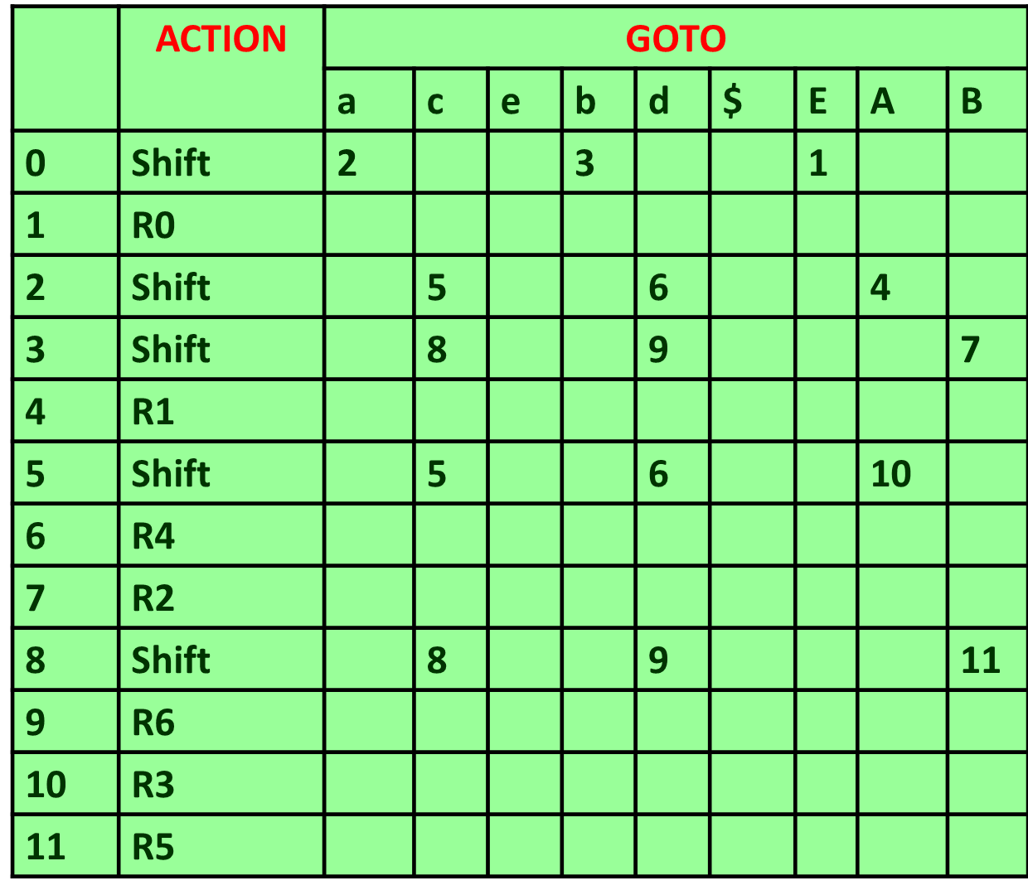
Augmented grammar G’：
(0) S’→E (1) E→aA
(2) E→bB (3) A→cA
(4) A→d (5) B→cB
(6) B→d
LR(0) parsing table
The DFA of sets of items
E→bB•
B→d•
I₇
I₉
B
d
c
d
E→b•B
I₃
b
c
B→c•B
B→•cB
B→•d
I₈
B
B→cB•
S’→•E
B→•cB
B→•d
I₁₁
I₀
E→•aA
E→•bB
I₂
a
E→a•A
A→c•A
A→•cA
A→•d
c
I₅
A
A→cA•
E
A→•cA
A→•d
I₁₀
S’→E•
I₁
A
d
d
c
E→aA•
20
I₄
A→d•
I₆
Notes:
20

